Slide 1
Integration of Information Models and Tools (IIM&T) HL7 CIMI Project
Update for
FHA Managing Board, December 7, 2016
Presented by
Steve Wagner and Nona Hall

Slide 2
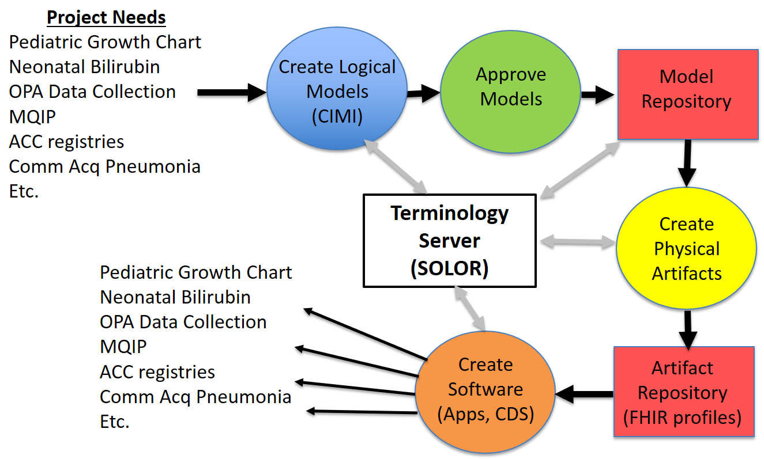

Better Implementation Products: Apps Based on Integrated/Reusable Models
CLIM
{SOLOR, FHIM, CIMI, CQF, …}
CLIM
(HL7/ISO
Balloted
Version)
ACC is American College of Cardiologists, COMM Acq is Community-acquired,
MQIP is Medicare Quality Improvement Program, OPA is Oropharyngeal Airway

Slide 3
Integration of Information Models and Tools (IIM&T) HL7 CIMI Project
COMMUNICATIONS:
IIM&T Newsletter is being developed
GOVERNANCE:
Technology Learning Center (TLC) is being investigated
PILOT STUDIES:
Wound Assessment Pilot Study is driving SOLOR, FHIM & CIMI alignment
EHR Function Model Profile for Immunization Management
INFRASTRUCTURE:
SOLOR, FHIM and CIMI alignment is underway
FHIM Requirements for SIGG are being developed
IPO’s DoD & VA JIF Proposal was Submitted

Slide 4
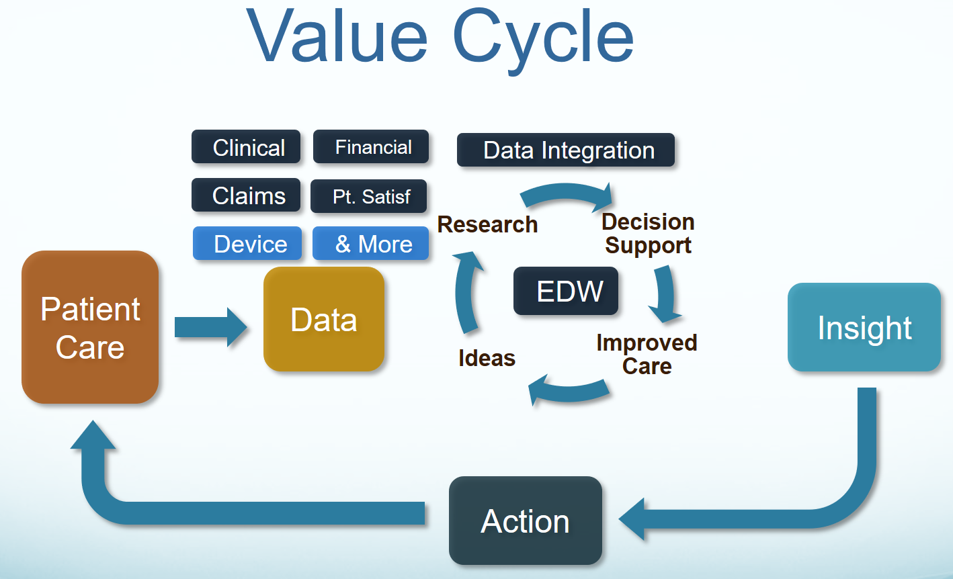
IT Objective
Our IT objective is to make the appropriate data available
when it is needed, where it is needed and how it is needed.

